Slide 1

SuperBigBite DAQ update
Bryan Moffit
Jefferson Lab
SBS DOE Review – November 2015

Slide 2
Outline
SBS requirements
Data Event Flow
Fastbus Readout
Event Switching
FADC HCAL readout
GEM readout
Timeline
Manpower

Slide 3

$G_{ E}^{p}$ DAQ requirements
Focal Plane Polarimeter
Front tracker
Back tracker GEM 128 K channels
288 channels HCAL on FADC ( 10 samples )
Electron detector
1800 channels ECAL
CDet 2152 Channels ( TDC )

Slide 4
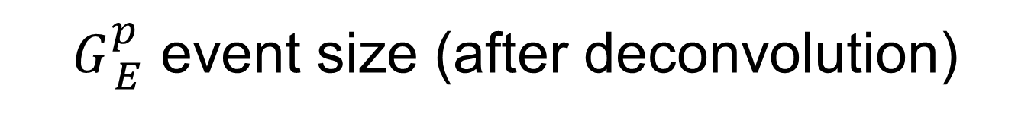
$G_{ E}^{p}$ event size (after deconvolution)
Detector | Channels | Single rate Hz | Occupancy 75 ns in % | Channels firing | Event size (bytes) | Data rate 5 KHz MB/s
Front tracker | 41,000 | 3.3e9 | 18.1 | 7430 | 136,000 | 90
Back tracker | 112,640 | 3.36e9 | 22.4 | 12600 | 230,000 | 150
HCal | 288 | _ | 100 | 288 | 7,200 | 36
ECAL | 1800 + 225 | _ | 100 | 2025 | 8,100 | 45
CDET | 2152 | _ | 10 | 216 | 864 | 4.3
Total |  |  |  |  |  | 325.3 MB/s
Includes geometrical matching
HCAL and ECAL occupancies need to be evaluated : using 100 % for now

Slide 5

$G_{ E}^{n},G_{ M}^{n}$ DAQ requirements
Bigbite
GEM 128 K channels
Shower 189 blocks (ADC)
Preshower 54 blocks (ADC)
Scintillator 180 bars 360 PMTs ( ADC/TDC)
Cerenkov 550 PMTs (TDC)
Neutron detector
288 channels HCAL ( FADC + high res TDC )
CDet 2152 Channels ( TDC )

Slide 6
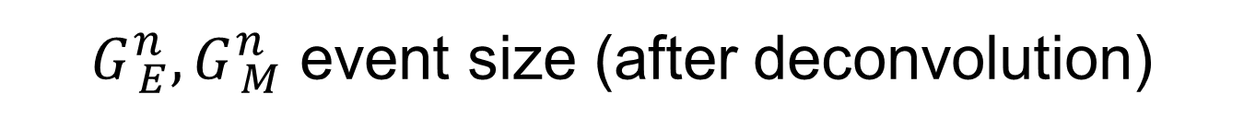
$G_{ E}^{n},G_{ M}^{n}$ event size (after deconvolution)
Arm | Detector | Channels | Single rate Hz | Occupancy 75 ns in % | Channels firing | Event size (bytes) | Data rate 5 KHz MB/s
BigBite | GEM | 112,640 | 2.6e9 | 8.7 | 5248 | 62,976 | 300
 | Lead glass | 243 | _ | 100 | 243 | 1003 | 5
 | Scintillators | 360 | _ | 100 | 360 | 1485 | 7.4
 | Cerenkov | 550 | _ | 100 | 550 | 2269 | 11.34
Neutron | HCal | 288 | _ | 100 | 288 | 7,200 | 36
 | HCAL time | 288 | _ | 100 | 288 | 1170 | 5.85
 | CDET | 2152 | _ | 10 | 216 | 864 | 4.3
Total at 5 KHz 370 MB/s Max

Slide 7
Fastbus update
Use new CODA 3.0 TI and TS
More flexibility in programming
Event blocking
Absolute timestamp for synchronization check
Trigger partitioning capability only use a subset of modules
Asked for modified firmware to DAQ group in May 2015 ( William Gu and Bryan Moffit )
Firmware being developed and tested

Slide 8
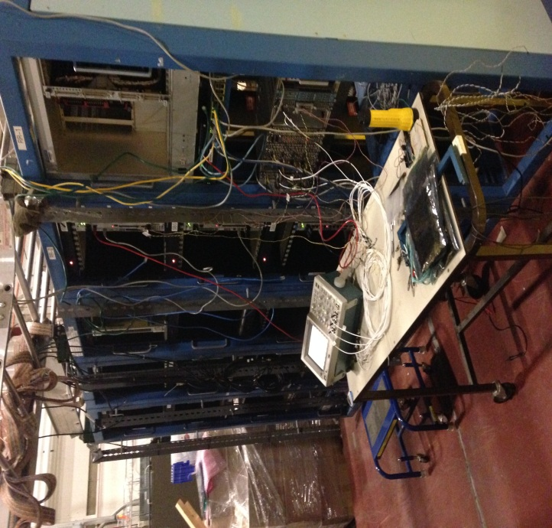
Fastbus update
Have sufficient TDCs, ADCs, crates, SFI, aux. cards
Making FB faster
sparsification – works
event blocking – works
event switching – being tested
merging with pipelining VME – to be tried
Three large Fastbus systems assembled in the test lab.
have 236
need 124
have 113
need 94
have 30
need 21
have 21
need 21
have 15 (20 being made)
need 30

Slide 9
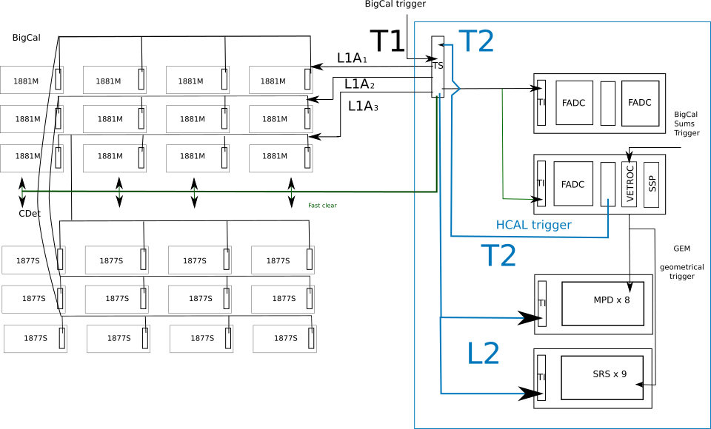
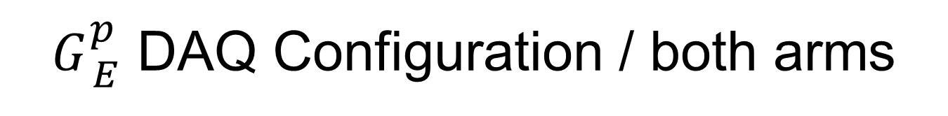
$G_{ E}^{p}$ DAQ Configuration / both arms
Fastbus
ECAL trigger
ECAL
ECAL
Sums
Trigger
L2
T2 distributed to Hadron and Electron Arms
SSP x 3
If no L2A, Fast Clear to Fastbus
TI provides timestamp for every event

Slide 10
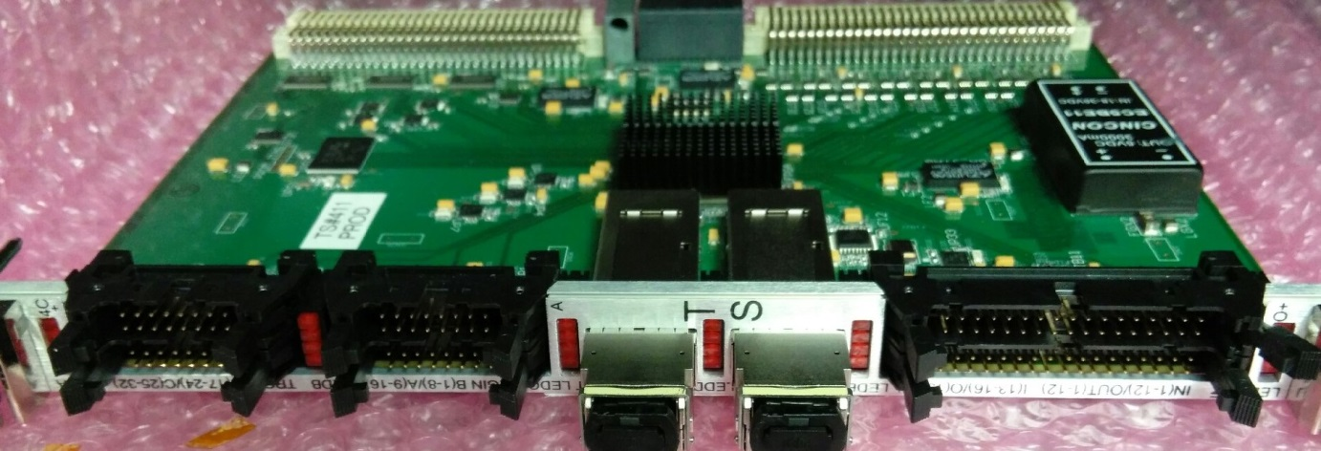
HallA SBS Trigger block diagram
Local Trigger
Lookup table
32x1
Trigger Rule
Width
Gate / Common Stop
BUSY
Width
Local Trigger
distribution
Width
Width
Delay
Match
Width
Fast
Clear
Delay
Match
Width
Delay
Match
Width
Delay
Match
Width
ReadOut Trigger
Delay, Prescale,
Lookup table,
Trigger Rule
Width Ext
Delay/Width
Trigger
word
second
word
Serializer
Serializer/Fiber
Serializer/Fiber
Readout Module Data

Slide 11
Single Crate vs. Trigger Switching
Readout trigger rate ~ 5 kHz
Buffer Level = 4
8ADC - (reading pedestals on 6 channels in each ADC)

Slide 12
HCAL
All FADC 16 delivered
2 VXS crates delivered
2 Intel Concurrent CPU delivered
Readout tested
Development of trigger using HPS firmware and Global Trigger Processor (GTP)
New VTP ordered

Slide 13
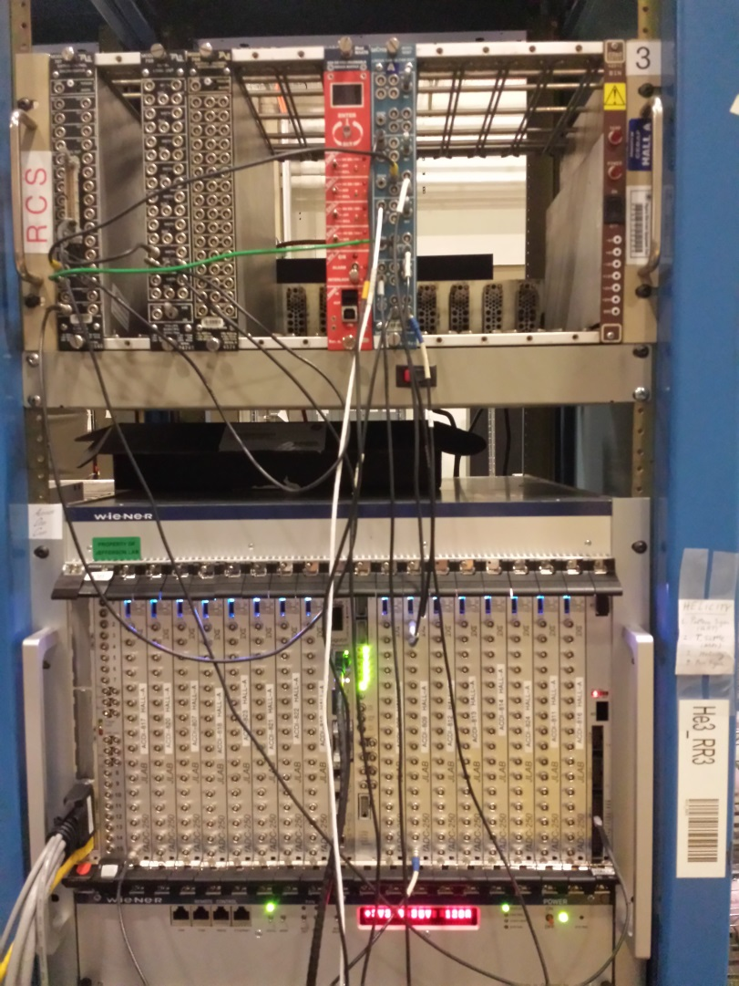
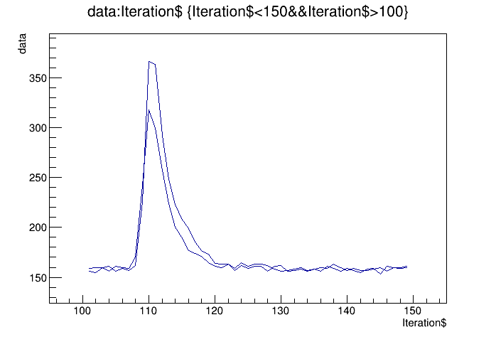
HCAL FADC electronics
Cosmics from calorimeter block
Will test later with HCAL module

Slide 14
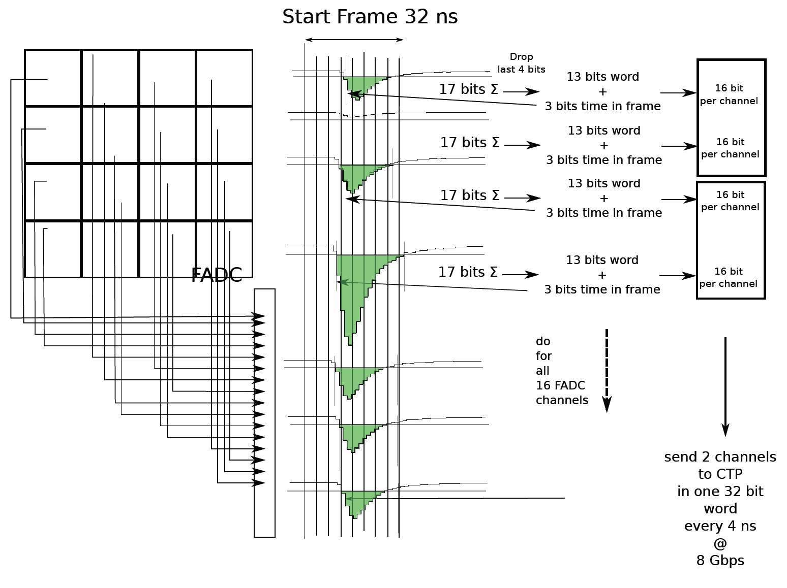
Hadron Arm - HCAL DAQ: proton trigger
HCal Signals to FADC inputs
2 VME switched Serial (VXS) Crates
JLAB FADC250, a 16-channel 12-bit FADC sampling at 250 MHz
16 FADC in VXS Crate 1
2 FADC in VXS Crate 2
If signal pass threshold
Integrates signal and subtracts pedestal
Sends time frame info
VTP (Crate Trigger Processor)
Located in VXS crates
Collects integrated signal and timing from FADC channels
Sends data to the second VTP for clustering

Slide 15
HCAL trigger development
HPS firmware installed on FADC and GTP
FADC readout tested with cosmics
Testing triggering capability
Need
implement decoder for analysis
Test using 2 crates and new VTP

Slide 16
GEM MPD readout
INFN MPD used for several years using custom C++ package
Package ported to intel CPU
New C library written for easy integration into CODA
( Bryan Moffit, Evaristo Cisbani, Danning Di )
CODA configuration running
Debugging module initialization

Slide 17
GEM optical link readout
Aurora protocol based
Implemented by Paolo Musico. To be tested.
2 Gbit optical link to SubSystem Processor (SSP) module
250 MB/s per link
Readout up to 32 MPD in parallel
8 GB/s bandwidth compared to ~100 MB/s using VME
SSP library
Readout routines – Completed.
MPD configuration routines – In progress
Link from MPD to SSP module
Implemented by Ben Raydo. Works.

Slide 18
Timeline
4th quarter 2015 | 1st quarter 2016 | 2st quarter 2016 | Future
Finish MPD CODA readout – debug Finish Fastbus Readout – debug Small scale setup 200 KHz L1 5 kHz coinc Fastbus, MPD, and HCAL FADC Cdet Fastbus Analysis software : check synchronization Test MPD optical readout (SSP) HCAL trigger ordered | Implement new HCAL Trigger module HCAL cosmics GEM cosmics with MPD Test GEM readout with optical link in high background at UVA Develop GEM analysis software | GEM installed on BigBite for tritium experiment ECal cosmics DVCS experiment Parasitic test: Fastbus and FADC setup | Tritium experiment Parasitic test: Fastbus and FADC setup

Slide 19
Manpower
Fastbus
JLAB : Dasuni Adikaram, Mark Jones, Robert Michaels, Bryan Moffit, William Gu
MPD
INFN : Evaristo Cisbani, Paolo Musico
UVA : Danning Di, Kondo Gnanvo, Nilanga Liyanage
JLAB : Ben Raydo, Bryan Moffit
Stony Brook : Seamus Riordan
HCAL
JLAB : Alexandre Camsonne, Ben Raydo, Bryan Moffit

Slide 20
Conclusion
Fastbus event switching works well
Preliminary results show acceptable dead time in experiment conditions
Need to develop software and check synchronization
HCAL:
FADC ready
trigger implemented and being tested
MPD:
CODA readout implemented
Debugging of the software driver
Optical readout in progress
Small scale test setup in a few weeks

Slide 21
Backup Slides

Slide 22
GE_{p}5
Focal Plane Polarimeter
Front tracker
Back tracker GEM 128 K channels
288 channels HCAL on FADC ( 10 samples )
Electron detector
1800 channels ECAL
CDet 2152 Channels ( TDC )

Slide 23
GEM data flow GEp
5 KHz trigger rate
SSP
Deconvolution
( factor 2)
FT=0.26 GB/s
BT=0.45GB/s
Keep Amplitude and time (3)
FT=0.09 GB/s
BT=0.15 GB/s
Total
240 MB/s
MPD
153 640
X 6 samples x 3 bytes
FT=5.99 GB/s
BT=10.2 GB/s
Total= 16.2 GB/s
MPD
Zero suppress
FT=1.63GB/s
BT=2.76 GB/s
Geometrical cut (factor 3)
FT=0.53 GB/s
BT=0.9 GB/s
Analog
GEM
153 640
strips
Assume 2.5 strips cluster size
Time window | 6x25 ns | 3x25 ns
Occupancy forward tracker in % | 36.2 | 18.1
Occupancy back tracker In % | 22.4 | 11.2
Need to test clustering and correlations betweens planes for further reduction

Slide 24
GEp5 event size ( after deconvolution and geomtrical matching)
Detector | Channels | Single rate Hz | Occupancy 75 ns in % | Channels firing | Event size (bytes) | Data rate 5 KHz MB/s
Front tracker | 41,000 | 3.3e9 | 18.1 | 7430 | 136,000 | 90
Back tracker | 128,000 | 3.36e9 | 22.4 | 12600 | 230,000 | 150
HCal | 288 | _ | 100 | 288 | 7,200 | 36
ECAL | 1800 + 225 | _ | 100 | 2025 | 8,100 | 45
CDET | 2152 | _ | 10 | 216 | 864 | 4.3
Total |  |  |  |  |  | 325.3 MB/s
HCAL and ECAL occupancies need to be evaluated : using 100 % for now

Slide 25
Analog
Optical 83x100 Mbit=10 GB/s
VME bus 3x100 MB/s
MPD
83 Boards
16.2 GB/s in
1430 MB/s out
(zero suppress, matching)
SSP
3 Boards
1430 MB/s in
Deconvolution
715 MB/s
Keep A and T
240 MB/s
GEM
153,640
Channels
VME
CPU
1 Gbit
Ethernet x3
= 375 MB/s max
FADC
18
Boards
36 MB/s
VME bus 2x100 MB\s
HCAL
288
Channels
VME
CPU
DAQ
Computer
325.3 MB/s
1 Gbit Ethernet x2
= 250 MB/s max
VME bus 12x20 MB\s
1 Gbit Ethernet x2
250 MB/s max
ECAL
1800
Channels
225 sums
Fastbus
96 Boards in 12 crates
45 MB/s = 3.5 MB/s per crate
VME
CPU
1 Gbit Ethernet
x12
Swi
tch
Typical SSD
has
500 MB/s rate
Fastbus
87 boards in 9 crates
Boards
4.3 MB/s = 1.1 MB/s crate
VME bus 9x20 MB\s
CDet
1176x2=
2352
Channels
VME
CPU
100 Mbit Ethernet
x9

Slide 26
GE_{n} and GM_{n}
Bigbite
GEM 128 K channels
Shower 189 blocks (ADC)
Preshower 54 blocks (ADC)
Scintillator 180 bars 360 PMTs ( ADC/TDC)
Cerenkov 550 PMTs (TDC)
Neutron detector
288 channels HCAL ( FADC + high res TDC )
CDet 2152 Channels ( TDC )

Slide 27
Gen trigger rates ( 95 % QE peak )
Q^2 | Rate [kHz]
1.5 | 3
4 | 0.4
7 | 0.09
10 | 0.06

Slide 28
GEM data flow GEp
5 KHz trigger rate
55 MPDs
112 640
X 6 samples x 3 bytes
= 10.3 GB/s
SSP
Deconvolution
( factor 2)
= 0.9 GB/s
Keep A & T
(factor 3)
=0.3 GB/s
Analog
GEM
112 640
strips
MPD
Zero suppress
= 1.8 GB/s
Time window | 6x25 ns | 3x25 ns
Occupancy back tracker In % | 17.4 | 8.7
Assume each MPD word packed on 24 bits = 3 bytes

Slide 29
Gen and GMn event size
Arm | Detector | Channels | Single rate Hz | Occupancy 150 ns in % | Channels firing | Event size (bytes) | Data rate 5 KHz MB/s
BigBite | GEM | 112,640 | 2.6e9 | 17.4 | 19680 | 359,775 | 1798
 | Lead glass | 243 | _ | 100 | 243 | 1003 | 5
 | Scintillators | 360 | _ | 100 | 360 | 1485 | 7.4
 | Cerenkov | 550 | _ | 100 | 550 | 2269 | 11.34
Neutron | HCal | 288 | _ | 100 | 288 | 7,200 | 36
 | HCAL time | 288 | _ | 100 | 288 | 1170 | 5.85
 | CDET | 2152 | _ | 10 | 216 | 864 | 4.3

Slide 30
Gen and GMn event size deconvoluted
Arm | Detector | Channels | Single rate Hz | Occupancy 100 ns in % | Channels firing | Event size (bytes) | Data rate 5 KHz MB/s
BigBite | GEM | 112,640 | 2.6e9 | 8.7 | 5248 | 62,976 | 300
 | Lead glass | 243 | _ | 100 | 243 | 1003 | 5
 | Scintillators | 360 | _ | 100 | 360 | 1485 | 7.4
 | Cerenkov | 550 | _ | 100 | 550 | 2269 | 11.34
Neutron | HCal | 288 | _ | 100 | 288 | 7,200 | 36
 | HCAL time | 288 | _ | 100 | 288 | 1170 | 5.85
 | CDET | 2152 | _ | 10 | 216 | 864 | 4.3
Total at 5 KHz 369.89 MB/s Max

Slide 31
Analog
Optical 83x100 Mbit=10 GB/s
VME bus 2x100 MB/s
MPD
55 Boards
1,030 MB/s in
1,800 MB/s out
(zero suppress)
SSP
3 Boards
1800 MB/s in
Deconvolution
300 MB/s out
GEM
112,640
Channels
VME
CPU
1 Gbit
Ethernet x2
= 250 MB/s max
FADC + TDC
18
Boards
42 MB/s
VME bus 2x100 MB\s
HCAL
288
Channels
VME
CPU
DAQ
Computer
369.9 MB/s
1 Gbit Ethernet x2
= 250 MB/s max
VME bus 12x20 MB\s
1 Gbit Ethernet x2
250 MB/s max
Bigbite
ADC
1153 channels
Fastbus
56 Boards in 12 crates
23.8 MB/s = 1.9 MB/s per crate
VME
CPU
1 Gbit Ethernet
x12
Swi
tch
Fastbus
87 boards in 9 crates
Boards
4.3 MB/s = 1.1 MB/s crate
VME bus 9x20 MB\s
CDet
1176x2=
2352
Channels
VME
CPU
100 Mbit Ethernet
x9

Slide 32
SILO
IBM TS3500 9 frames ( up to 15 )
( up to 12 drives per frame)
10 LTO 5 1.5 TB 140 MB/s
6 LTO 6 2.5 TB 160 MB/s
(LTO7 6 TB 300 MB/s)
DAQ computer
10 GigE
1.25 GB/s
Disk array
SSD or RAID
TS3500 frame 1000 slots : 25 K$
Data mover 10 K$ each 160 MB/s

Slide 33
Tape cost 250 MB/s
 |  | Days | Data rate | Seconds | Total data TB | Double | DLO5 in $ | DLO6 in $ | Tape DLO6
E12-12-09-019 | GMN | 25 | 250 | 2160000 | 540 | 1080 | 54000 | 32400 | 216
E12-09-016 | GEN | 50 | 250 | 4320000 | 1080 | 2160 | 108000 | 64800 | 432
E12-07-109 | GEP/GMP | 45 | 250 | 3888000 | 972 | 1944 | 97200 | 58320 | 388.8
E12-09-018 | SIDIS | 64 | 250 | 5529600 | 1382.4 | 2764.8 | 138240 | 82944 | 552.96
 | Total | 184 |  | 15897600 | 3974.4 | 7948.8 | 397440 | 238464 | 1589.76
Actual days | Actual years |  | Time in s |  |  | Per year | 394200 | 236520
368 | 1.01 | 184 | 15897600
1 600 LTO6 tapes for 240 K$, if go to 500 MB/s 480 K$
2 frames with 8 data movers 130 K$

Slide 34
Conclusion
Estimated rate for max 5 KHz ( expect to run at 2 to 3 KHz )
325.3 MB/s for GEp5
370 MB/s for GEn ( no geometrical correlation)
Will work on clustering and plane coincidence in SSP, reduction factor to be determined using simulation
Need implement hardware and test

